Slide 1
Point Coordination Function
Submitted by : Amar Nath
Roll no : 04

Slide 2
Point Coordination Function (PCF)
Point coordination function (PCF) is an optional technique used to prevent collisions in IEEE 802.11-based WLAN standard including Wi-Fi. It is a medium access control (MAC) sublayer technique used in areas where carrier-sense multiple access with collision avoidance (CSMA/CA) is used.
PCF is used additionally along with the mandatory distributed coordination function (DCF). It is used in centralised control system, and is present in the access point (AP) of the wireless network. An AP is generally a wireless router that coordinates network communication.

Slide 3
Features of PCF
∆ It is an optional function that resides on the top of the mandatory DCF. Both PCF and DCF operate simultaneously.
∆ It provides channel access to the stations using poll and response method thus eliminating the need of contention.
∆ The polling is done by the point co-ordinator (PC) that resides in central access point (AP).
∆ The station waits for Point Inter–Frame Space (PISF) before transmission. PISF is typically smaller than DIFS (Distributed Inter-Frame Space) as used in DCF.
∆ PC polls in a round – robin method to provide access to the stations in the wireless network.
∆ AP issues a special control frame called beacon frame to initiate and repeat polling.

Slide 4
PCF Interframe Space
PCF Interframe Space (PIFS) is one of the interframe space used in IEEE 802.11 based Wireless LANs. PCF enabled access point wait for PIFS duration rather than DIFS to occupy the wireless medium. PIFS duration is less than DIFS and greater than SIFS (DIFS > PIFS > SIFS). Hence AP always has more priority to access the medium.
PIFS duration can be calculated as follows : PIFS = SIFS + Slot time

Slide 5
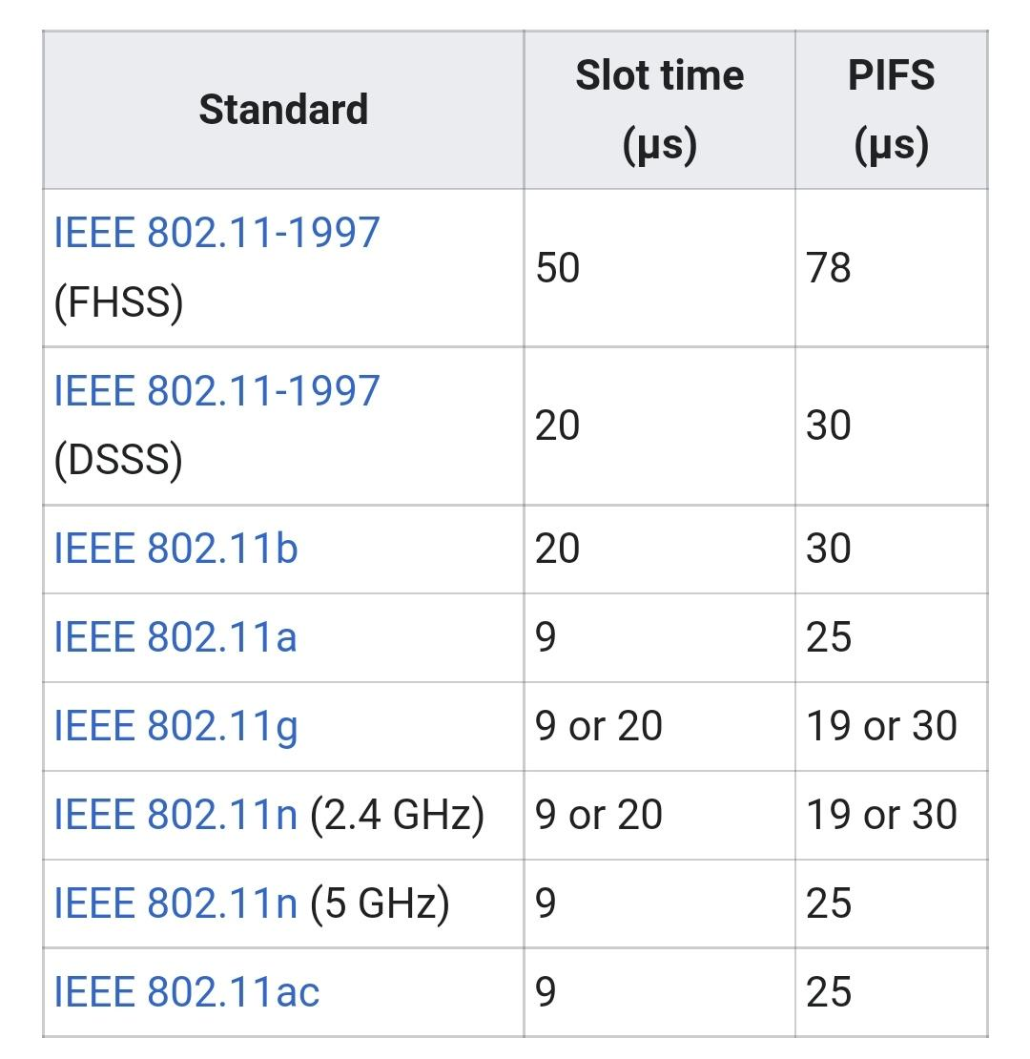

Slide 6
Technique
Step 1 − PC sends a beacon frame after waiting for PIFS. The beacon frame reaches every station in the wireless network.
Step 2 − If AP has data for a particular station, say station X, it sends the data and a grant to station X.
Step 3 − When station X gets the grant from the AP, if it has a data frame for AP, it transmits data and acknowledgement (ACK) to the AP.
Step 4 − On receiving data from station X, the AP sends an ACK to it.
Step 5 − The AP then sends goes to the next station, say station Y. If AP has data for Y, it sends data and grant to Y, otherwise it sends only grant to Y.

Slide 7
Step 6 − On receiving grant from AP, station Y transmits its data (if any) to AP.
Step 7 − This process continues for all the stations in the poll.
Step 8 − At the end of granting access to all the stations, the AP sends an ACK to the last station. It then notifies all stations that this is the end of polling.

Slide 8
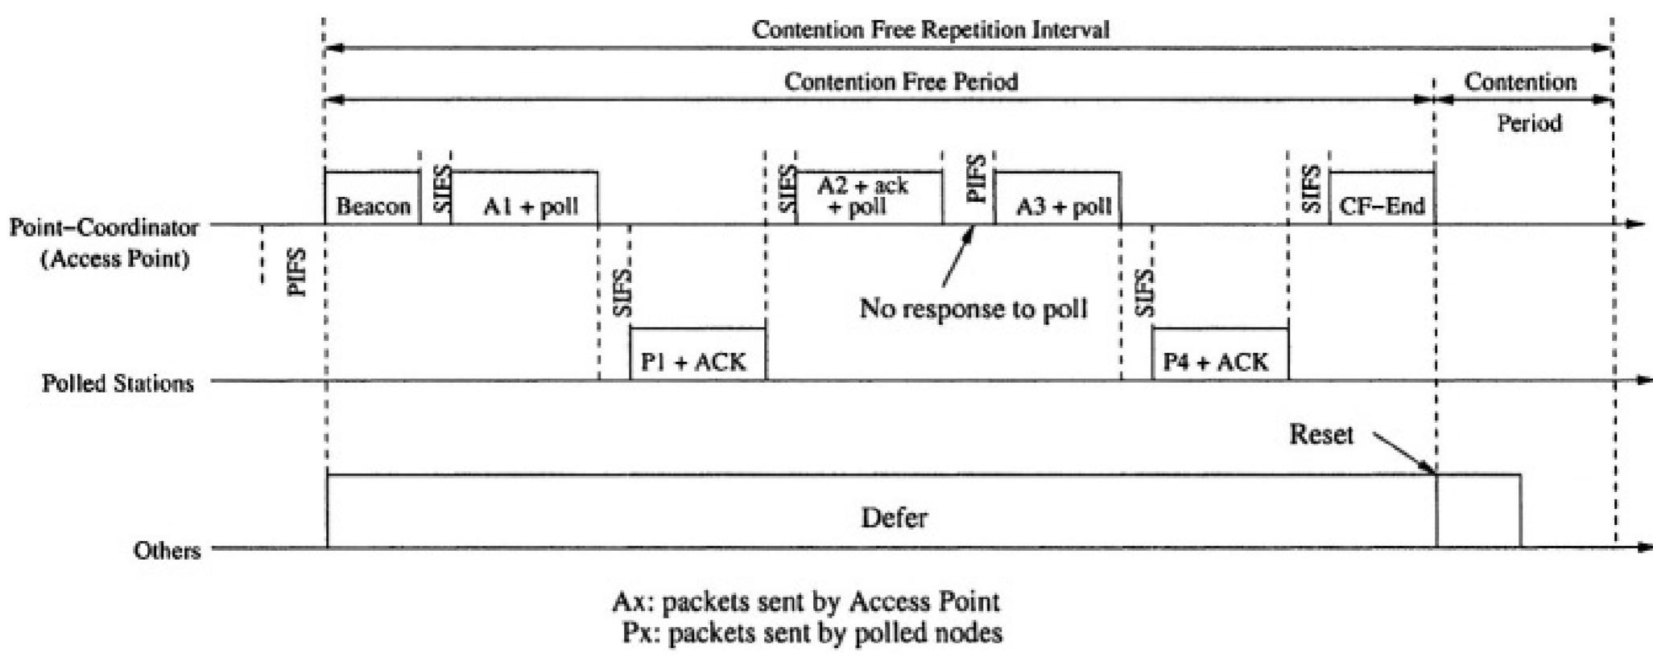

Slide 9
References
https://www.researchgate.net/publication/226352208_Transport_Layer_Protocols_in_Ad_Hoc_Networks
https://www.tutorialspoint.com/point-coordination-function-pcf
https://en.m.wikipedia.org/wiki/Point_coordination_function

Slide 10
Thank You

